Slide 1
Cystic Ovaries in Cattle

Slide 2
Introduction
There are several types of cysts that can be found on the ovaries of the cow, which can
have a significant impact on the reproductive efficiency of the animal.
The cystic structures that
were studied included follicular cysts, luteal cysts, and cystic corpora lutea

Slide 3
Introduction
The importance of studying cystic conditions lies in the consequences they have for the
dairy producer. As most cysts are anovulatory, they cause severe delays in the reproductive
efficiency of affected animals, leading to decreased milk production over time. This inevitably
can affect the bottom line and cause the dairy producer to lose money.

Slide 4
Follicular Cysts
Definitions and Characteristics
The usual incidence of follicular cysts in cows is 10% to 15%, but incidences as high as30%
have been reported and confirmed by ultrasonography and rectal palpation
Single or multiple on one or both ovaries Some remain as thin-walled
and produce estrogens primarily, along with a higher concentration of androgens
The result is usually continuous or chronic estrus (3- 10 )days between heats a condition referred to as nymphomania.

Slide 5
Follicular Cysts
If condition continues for an extended period of time,
the cow develops an apparent high tail head caused
by the relaxation of the pelvic ligaments permitting
The pelvis to tilt forward and develops a masculine
neck, and the cow may bellow like a bull.
However, some evidence indicates a deficiency of luteinizing hormone or its receptors in the ovarian
follicle

Slide 6
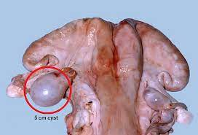
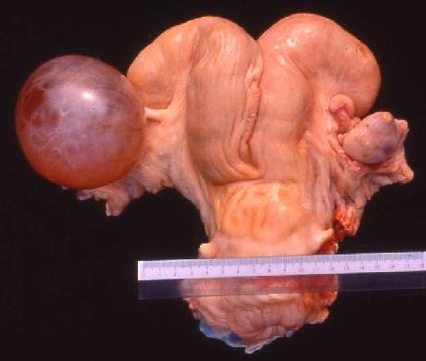
Follicular Cysts

Slide 7
Treatment
Early diagnosis and treatment enhance success. Large
doses of LH, hCG about (10,000 IU,IM or 5000IU,IV), and GnRH
have been used intravenously and intramuscularly to initiate rupture of these cysts. Both LH
and hCG act directly on the cysts, while GnRH produces an LH surge similar to a preovulatory
surge and causes the cysts to rupture, followed by normal estrous cycles in cows

Slide 8
Luteinized Follicles
high percentage of thick-walled cysts become luteinized. The luteal tissue produces progesterone
and the follicular fluid is usually high in progesterone. Usually single on one overy cysts resulting in a greatly enlarged ovary
The condition is usually characterized by
long periods of anestrus.

Slide 9
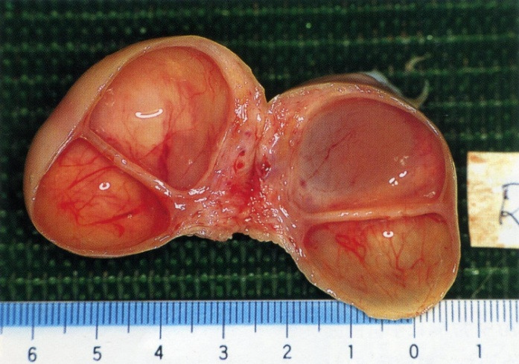
Luteinized Follicles

Slide 10
                Treatment
for luteal cysts is GnRH, followed in (10 to
14 )days with PGF2a.
The material must be fed for( 2 to 3)weeks or until the cyst has regressed
as determined by rectal palpation. Use of PGF2a may prove to be an effective treatment.

Slide 11
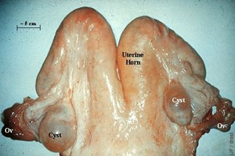

Slide 12
Cystic Corpus Luteum
The cystic CL differs from the luteinized follicle even though some similarities exist.
while the cystic CL contains a cavity which is usually filled with fluid, its origin is the same as
that of a normal corpus luteum. In the early stages of development of the CL

Slide 13
Cystic Corpus Luteum
The normal cavities, usually (7 mm or 8 mm) in diameter Larger
The cystic corpus luteum is considered to contribute to early
embryonic mortality.
CL Infertile cows, a high percentage had cystic
whereas none were seen in aged fertile cows.

Slide 14
The corpus luteum is called permanent if it lasts more than (30-25) days after birthThe permanent corpus luteum inhibits the growth and maturation of new Graf's follicles
This leads to a disruption in the regularity of estrus cycles and a prolongation of infertility in cows

Slide 15
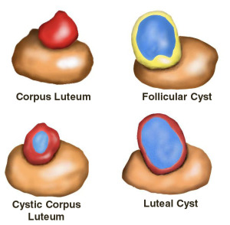

Slide 16
THAK YOU

